Slide 1

Professional Ethics and Human Values
ETHICS FOR IT WORKERS
AND IT USERS

Slide 2
Queensland, the second largest state in Australia, awarded an outsourcing contract to IBM to build a new payroll application for its Department of Health at an initial cost estimate of $5 million.
The project, however, went horribly wrong.
Among other issues, the resulting system, delivered many months late, generated incorrect checks for some staff and no checks at all for others.
As efforts mounted to fix the problems, the project cost ballooned out of control, eventually reaching more than $1 billion.
Subsequent investigation by the state led to the allegations that IBM employees had acted unethically during the bidding process.
In a report issued after the investigation, the Queensland government asserted that it would not have contracted with IBM were it not for misrepresentations made by IBM regarding its expertise as well as the true project costs.
For its part, IBM claimed that Queensland employees did a terrible job in managing the project—a claim supported by the state’s own investigation.

Slide 3
IT WORKER RELATIONSHIPS THAT MUST BE MANAGED
IT workers typically become involved in many different work relationships, including those with employers, clients, suppliers, other professionals, IT users, and society at large.
In each relationship, an ethical IT worker acts honestly and appropriately. These various relationships are discussed in the following sections.

Slide 4
Relationships Between IT Workers and Employers
IT workers and employers have a critical, multifaceted relationship that requires ongoing effort by both parties to keep it strong.
An IT worker and an employer typically agree on the fundamental aspects of this relationship before the worker accepts an employment offer.
These issues may include job title, general performance expectations, specific work responsibilities, drug-testing requirements, dress code, location of employment, salary, work hours, and company benefits.
Many other aspects of this relationship may be addressed in a company’s policy and procedures manual or in the company’s code of conduct, if one exists.

Slide 5
Relationships Between IT Workers and Employers
Topics addressed in such a manual or code of conduct might include protection of company secrets; vacation policy; time off allowed for a funeral or an illness in the family; tuition reimbursement; and use of company resources, including computers and networks.
Other aspects of this relationship develop over time, depending on circumstances (for example, whether the employee can leave early one day if the time is made up another day).
Some aspects are addressed by law—for example, an employee cannot be required to do anything illegal, such as falsify the results of a quality assurance test.
Some issues are specific to the role of the IT worker and are established based on the nature of the work or project—for example, the programming language to be used, the type and amount of documentation to be produced, and the extent of testing to be conducted.

Slide 6
Relationships Between IT Workers and Employers
As the stewards of an organization’s IT resources, IT workers must set an example and enforce policies regarding the ethical use of IT.
IT workers often have the skills and knowledge to abuse systems and data or to enable others to do so.
Software piracy is an area in which IT workers may be tempted to violate laws and policies.
Although end users often get the blame when it comes to using illegal copies of commercial software, software piracy in a corporate setting is sometimes directly traceable to IT staff members—either they allow it to happen or they actively engage in it, often to reduce IT-related spending.

Slide 7
Relationships Between IT Workers and Employers
Trade secrecy is another area that can present challenges for IT workers and their employers.
A trade secret is information, generally unknown to the public, that a company has taken strong measures to keep confidential.
It represents something of economic value that has required effort or cost to develop and that has some degree of uniqueness or novelty.
Trade secrets can include the design of new software code, hardware designs, business plans, the design of a user interface to a computer program, and manufacturing processes.

Slide 8
Relationships Between IT Workers and Employers
Another issue that can create friction between employers and IT workers is whistleblowing.
Whistle-blowing is an effort by an employee to attract attention to a negligent, illegal, unethical, abusive, or dangerous act by a company that threatens the public interest.
Whistle-blowers often have special information based on their expertise or position within the offending organization.

Slide 9
Relationships Between IT Workers and Employers
For example, an employee of a computer chip manufacturing company may know that the chemical process used to make the chips is dangerous to employees and the general public.
A conscientious employee would call the problem to management’s attention and try to correct it by working with appropriate resources within the company.
But what if the employee’s attempt to correct the problem through internal channels was thwarted or ignored?
The employee might then consider becoming a whistle-blower and reporting the problem to people outside the company, including state or federal agencies that have jurisdiction.
Obviously, such actions could have negative consequences on the employee’s job, perhaps resulting in retaliation and firing.

Slide 10
Relationships Between IT Workers and Clients
IT workers provide services to clients; sometimes those “clients” are coworkers who are part of the same company as the IT worker.
In other cases, the client is part of a different company.
In relationships between IT workers and clients, each party agrees to provide something of value to the other.
Generally speaking, the IT worker provides hardware, software, or services at a certain cost and within a given time frame.

Slide 11
Relationships Between IT Workers and Clients
For example, an IT worker might agree to implement a new accounts payable software package that meets a client’s requirements.
The client provides compensation, access to key contacts, and perhaps a work space.
This relationship is usually documented in contractual terms—who does what, when the work begins, how long it will take, how much the client pays, and so on.
Although there is often a vast disparity in technical expertise between IT workers and their clients, the two parties must work together to be successful.

Slide 12
Relationships Between IT Workers and Clients
Typically, the client makes decisions about a project on the basis of information, alternatives, and recommendations provided by the IT worker.
The client trusts the IT worker to use his or her expertise and to act in the client’s best interests.
The IT worker must trust that the client will provide relevant information, listen to and understand what the IT worker says, ask questions to understand the impact of key decisions, and use the information to make wise choices among various alternatives.
Thus, the responsibility for decision making is shared between the client and the IT worker.

Slide 13
Relationships Between IT Workers and Clients
One potential ethical problem that can interfere with the relationship between IT workers and their clients involves IT consultants or auditors who recommend their own products and services or those of an affiliated vendor to remedy a problem they have detected.
Such a situation has the potential to undermine the objectivity of an IT worker due to a conflict of interest—a conflict between the IT worker’s (or the IT firm’s) self-interest and the client’s interests.
    For example, an IT consulting firm might be hired to assess a firm’s IT strategic plan.
    After a few weeks of analysis, the consulting firm might provide a poor rating for the existing strategy and insist that its proprietary products and services are required to develop a new strategic plan.
    Such findings would raise questions about the vendor’s objectivity and the trustworthiness of its recommendations.

Slide 14
Relationships Between IT Workers and Clients
Fraud is the crime of obtaining goods, services, or property through deception or trickery. Fraudulent misrepresentation occurs when a person consciously decides to induce another person to rely and act on a misrepresentation. To prove fraud in a court of law, prosecutors must demonstrate the following elements:
  The wrongdoer made a false representation of material fact.
  The wrongdoer intended to deceive the innocent party.
  The innocent party justifiably relied on the misrepresentation.
  The innocent party was injured.
Misrepresentation is the misstatement or incomplete statement of a material fact.
If the misrepresentation causes the other party to enter into a contract, that party may have the legal right to cancel the contract or seek reimbursement for damages.

Slide 15
Relationships Between IT Workers and Clients
Breach of contract occurs when one party fails to meet the terms of a contract.
Further, a material breach of contract occurs when a party fails to perform certain express or implied obligations, which impairs or destroys the essence of the contract.
Because there is no clear line between a minor breach and a material breach, determination is made on a case-by-case basis.
“When there has been a material breach of contract, the non-breaching party can either:
  (1) withdraw the contract, seek restitution of any compensation paid under the contract to the breaching party, and be discharged from any further performance under the contract; or
  (2) treat the contract as being in effect and sue the breaching party to recover damages.”

Slide 16
Relationships Between IT Workers and Clients
Most IT projects are joint efforts in which vendors and customers work together to develop a system.
Assigning fault when such projects go wrong can be difficult; one side might be partially at fault, while the other side is mostly at fault.
Clients and vendors often disagree about who is to blame in such circumstances.

Slide 17
Relationships Between IT Workers and Clients
Frequent causes of problems in IT projects include the following
  Scope creep—Changes to the scope of the project or the system requirements can result in cost overruns, missed deadlines, and a project that fails to meet end-user expectations.
  Poor communication—Miscommunication or a lack of communication between customer and vendor can lead to a system whose performance does not meet expectations.
  Delivery of an obsolete solution—The vendor delivers a system that meets customer requirements, but a competitor comes out with a system that offers more advanced and useful features.
  Legacy systems—If a customer fails to reveal information about legacy systems or databases that must connect with the new hardware or software at the start of a project, implementation can become extremely difficult.

Slide 18
Relationships Between IT Workers and Suppliers
IT workers deal with many different hardware, software, and service providers.
Most IT workers understand that building a good working relationship with suppliers encourages the flow of useful communication as well as the sharing of ideas.
Such information can lead to innovative and cost-effective ways of using the supplier’s products and services that the IT worker may never have considered.
IT workers can develop good relationships with suppliers by dealing fairly with them and not making unreasonable demands.
Threatening to replace a supplier who can’t deliver needed equipment tomorrow, when the normal industry lead time is one week, is aggressive behavior that does not help build a good working relationship.

Slide 19
Relationships Between IT Workers and Suppliers
Suppliers strive to maintain positive relationships with their customers in order to make and increase sales.
To achieve this goal, they may sometimes engage in unethical actions—for example, offering an IT worker a gift that is actually intended as a bribe.
Clearly, IT workers should not accept a bribe from a vendor, and they must be careful when considering what constitutes a bribe.
For example, accepting invitations to expensive dinners or payment of entry fees for a golf tournament may seem innocent to the recipient, but it may be perceived as bribery by an auditor.

Slide 20
Relationships Between IT Workers and Suppliers
Bribery is the act of providing money, property, or favors to someone in business or government in order to obtain a business advantage.
An obvious example is a software supplier sales representative who offers money to another company’s employee to get its business.
This type of bribe is often referred to as a kickback or a payoff.
The person who offers a bribe commits a crime when the offer is made, and the recipient is guilty of a crime if he or she accepts the bribe.

Slide 21
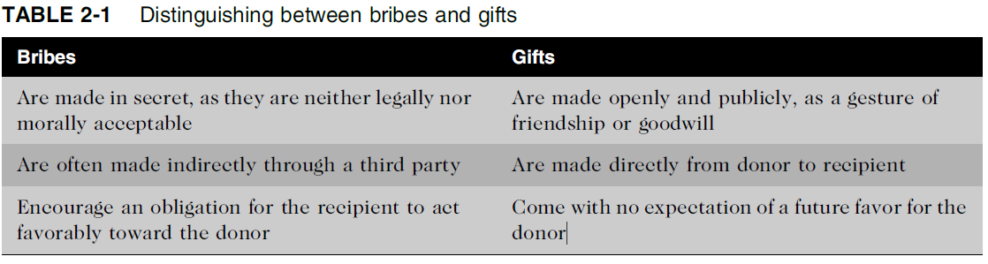
Relationships Between IT Workers and Suppliers

Slide 22
Relationships Between IT Workers and Other Professionals
Professionals often feel a degree of loyalty to the other members of their profession.
As a result, they are often quick to help each other obtain new positions but slow to criticize each other in public.
Professionals also have an interest in their profession as a whole, because how it is perceived affects how individual members are viewed and treated.
(For example, politicians are not generally thought to be very trustworthy, but teachers are.)
Hence, professionals owe each other an adherence to the profession’s code of conduct.
Experienced professionals can also serve as mentors and help develop new members of the profession.

Slide 23
Relationships Between IT Workers and Other Professionals
A number of ethical problems can arise among members of the IT profession.
One of the most common is résumé inflation, which involves lying on a résumé by, for example, claiming competence in an IT skill that is in high demand.
Even though an IT worker might benefit in the short term from exaggerating his or her qualifications, such an action can hurt the profession and the individual in the long run.
Many employers consider lying on a résumé as grounds for immediate dismissal.

Slide 24
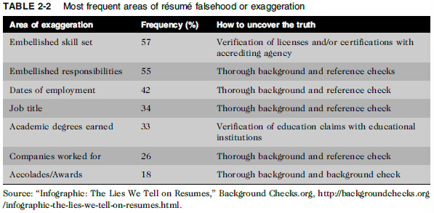
Relationships Between IT Workers and Other Professionals

Slide 25
Relationships Between IT Workers and Other Professionals
Another ethical issue that can arise in relationships between IT workers and other professionals is the inappropriate sharing of corporate information.
Because of their roles, IT workers may have access to corporate databases of private and confidential information about employees, customers, suppliers, new product plans, promotions, budgets, and so on.
It might be sold to other organizations or shared informally during work conversations with others who have no need to know.
Revealing such private or confidential information is grounds for termination in many organizations and could even lead to criminal charges.

Slide 26
Relationships Between IT Workers and IT Users
The term IT user refers to a person who uses a hardware or software product; the term distinguishes end users from the IT workers who develop, install, service, and support the product.
IT users need the product to deliver organizational benefits or to increase their productivity.
IT workers have a duty to understand a user’s needs and capabilities and to deliver products and services that best meet those needs—subject, of course, to budget and time constraints.
They also have a key responsibility to establish an environment that supports ethical behaviors by users.
Such an environment discourages software piracy, minimizes the inappropriate use of corporate computing resources, and avoids the inappropriate sharing of information.

Slide 27
Relationships Between IT Workers and Society
Regulatory laws establish safety standards for products and services to protect the public.
However, these laws are less than perfect, and they cannot safeguard against all negative side effects of a product or process.
Often, professionals can clearly see the effect their work will have and can take action to eliminate potential public risks.
Thus, society expects members of a profession to provide significant benefits and to not cause harm through their actions.
One approach to meeting this expectation is to establish and maintain professional standards that protect the public.

Slide 28
Relationships Between IT Workers and Society
Clearly, the actions of an IT worker can affect society. For example, a systems analys may design a computer-based control system to monitor a chemical manufacturing process.
A failure or an error in the system may put workers or people who live near the plan at risk.
As a result, IT workers have a relationship with members of society who may be affected by their actions.
There is currently no single, formal organization of IT workers that takes responsibility for establishing and maintaining standards that protect the public.
However, as discussed in the following sections, there are a number of professional organizations that provide useful professional codes of ethics to guide actions that support the ethical behavior of IT workers.

Slide 29
Encouraging the Professionalism of IT Workers
A professional is one who possesses the skill, good judgment, and work habits expected from a person who has the training and experience to do a job well.
Organizations— including many IT organizations—are desperately seeking workers who have the following characteristics of a professional:
  They are an expert in the tools and skills needed to do their job.
  They adhere to high ethical and moral standards.
  They produce high quality results.
  They meet their commitments.
  They communicate effectively.
  They train and develop others who are less skilled or experienced.

Slide 30
Encouraging the Professionalism of IT Workers
IT workers of all types can improve their profession’s reputation for professionalism by
(1) subscribing to a professional code of ethics,
(2) joining and participating in professional organizations,
(3) obtaining appropriate certifications, and
(4) supporting government licensing where available.

Slide 31
Encouraging the Professionalism of IT Workers
Professional Codes of Ethics
A professional code of ethics states the principles and core values that are essential to the work of a particular occupational group. Practitioners in many professions subscribe to a code of ethics that governs their behavior.
Eg, Doctors, Policeman, Firefighter and so on.
Most codes of ethics created by professional organizations have two main parts:
The first outlines what the organization aspires to become and the second typically lists rules and principles by which members of the organization are expected to abide.
Many codes also include a commitment to continuing education for those who practice the profession.

Slide 32
Encouraging the Professionalism of IT Workers
Professional Organizations
No one IT professional organization has emerged as preeminent, so there is no universal code of ethics for IT workers.
However, the existence of such organizations is useful in a field that is rapidly growing and changing. In order to stay on the top of the many new developments in their field, IT workers need to network with others, seek out new ideas, and continually build on their personal skills and expertise.
Whether you are a freelance programmer or the CIO of a Fortune 500 company, membership in an organization of IT workers enables you to associate with others of similar work experience, develop working relationships, and exchange ideas.
These organizations disseminate information through email, periodicals, websites, social media, meetings, and conferences.

Slide 33
Encouraging the Professionalism of IT Workers
Professional Organizations
Furthermore, in recognition of the need for professional standards of competency and conduct, many of these organizations have developed codes of ethics.
Four of the most prominent IT-related professional organizations are.
Association for Computing Machinery (ACM)
Institute of Electrical and Electronics Engineers Computer Society (IEEE-CS)
Association of Information Technology Professionals (AITP)
SysAdmin, Audit, Network, Security (SANS) Institute

Slide 34
Encouraging the Professionalism of IT Workers
Certification
Certification indicates that a professional possesses a particular set of skills, knowledge, or abilities, in the opinion of the certifying organization.
On the other hand, because certification is no substitute for experience and doesn’t guarantee that a person will perform well on the job, some hiring managers are rather cynical about the value of certifications.
Most IT employees are motivated to learn new skills, and certification provides a structured way of doing so.
For such people, completing a certification provides clear recognition and correlates with a plan to help them continue to grow and advance in their careers.

Slide 35
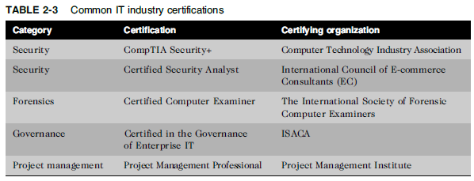
Encouraging the Professionalism of IT Workers

Slide 36
Encouraging the Professionalism of IT Workers
Licensing of IT Professionals
In the United States, a government license is government-issued permission to engage in an activity or to operate a business.
Licensing is generally administered at the state level and often requires that the recipient pass a test of some kind.
Some professionals must be licensed, including certified public accountants (CPAs), lawyers, doctors, various types of medical and daycare providers, and some engineers.

